Slide 1
Business Innovation Stock Trades
Team Dhaka(Ayobami Adebowale, Sarthak Agrawal, Gregory Prawdzik)

Slide 2
How we are choosing our stocks.
3 team members; 4 stock picks
Each team member will pick one stock using their own criteria.
The team will vote on 1 group purchase of the restricted choice stock.
Each team member will come up with a group of interesting stocks, then use analysis to select one to purchase.

Slide 3
Greg’s Pick
Options:
Tesla
Salesforce.com
Shopify
Intuitive Surgical
Fiverr International

Slide 4
Greg’s Pick
Analysis
MC-E ratios (Professors Innovation Calculation) 25%
Shopify 28.4 and Fiverr 26.6 Very High (9)
Tesla 10.7 and Intuitive Surgical 11.25 High (4)
Sales Force 5.15 Low (2.5)
PE Ratio (Lower = Better Value) 50%
Salesforce 64 (9) and Intuitive Surgical 87 (8) Lowest
Shopify 533 High (4)
Tesla 1230 Very High (1)
Fiverr None (0)

Slide 5
Greg’s Pick
Analysis
PEG (Lower is better Value) 25%
Tesla 1.5 (8) Lowest
Salesforce 3.4 (5) and Intuitive Surgical 5.9 (3) Higher
Shopify and Fiverr None (0)

Slide 6
Greg’s Pick
Calculation
Tesla
0.25(4) + 0.5(1) + 0.25(8) = 1 + 0.5 + 2 = 3.5
Salesforce.com
0.25(2.5) + 0.5(9) + 0.25(5) =0.625 + 4.5 + 1.25 = 6.375
Shopify
0.25(9) + 0.5(4) + 0.25(0) = 2.25 + 2 + 0 = 4.25
Intuitive Surgical
0.25(4) + 0.5(8) + 0.25(3) = 1 + 4 + 0.75 = 5.75
Fiverr International
0.25(9) + 0.5(0) + 0.25(0) = 2.25 + 0 + 0 =2.25

Slide 7
Greg’s Pick
Salesforce.com (CRM)
March 5th Price Per Share: $210.01
Number of Shares Purchased: 119
Total Purchase Price: $24991.19
Leftover Cash: $8.81

Slide 8
Ayobami’s Pick
Starbucks(SBUX)
Predicting strong revenues as restrictions lifted.
Tesla (TSLA)
Predicting strong second quarter.
Ulta! (ULTA)
Predicting strong revenues as restrictions lifted.
PE ratio ½ of Starbucks
Best Analyst Consensus

Slide 9
Ayobami’s Pick
Ulta (ULTA)
March 5th Price Per Share: $330.00
Number of Shares Purchased: 75
Total Purchase Price: $24,750
Leftover Cash: $250

Slide 10
Sarthak’s Pick
How Innovative?
AIRBNB
Post-pandemic , after the vaccines people will start travelling the world again. Step Outside.
Airbnb preferred over other hospitalities, more comfort zone.
Helps both ways : Renting their houses & people renting the houses.
Cost Effective, Flexible, more amenities.

Slide 11
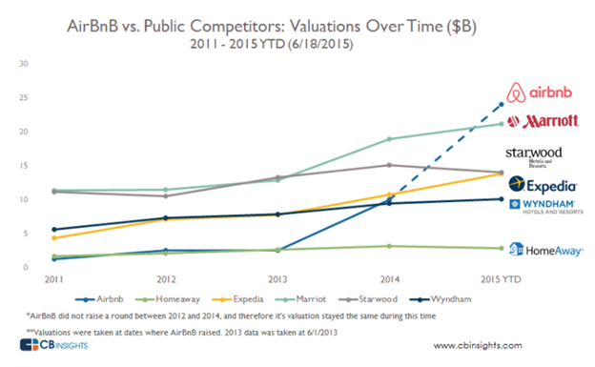
Sarthak’s Pick
Why an investment equity?

Slide 12
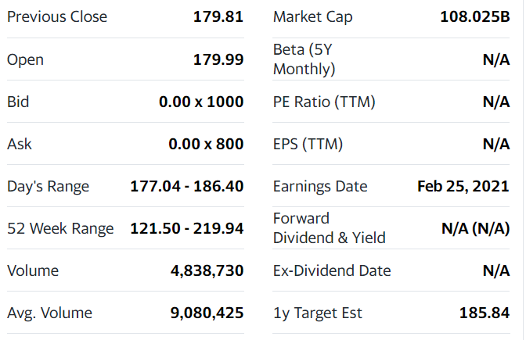
Sarthak’s Pick
Statistics
AirBnB (ABNB)
March 5th Price Per Share: $182.52 March 9th Opening price: $187 (pre-Market)
Number of Shares Purchased: 136
Total Purchase Price: $24,882.72
Leftover Cash: $177.28

Slide 13
Sarthak’s Pick
Closing
Expected to grow upto: $240
Initial purchase price: $182
Change expected: $58
Total Purchase on March 5th: $ 24882
Outcome by end (expected): $32640
Total profit (expected): $7800 approx.

Slide 14
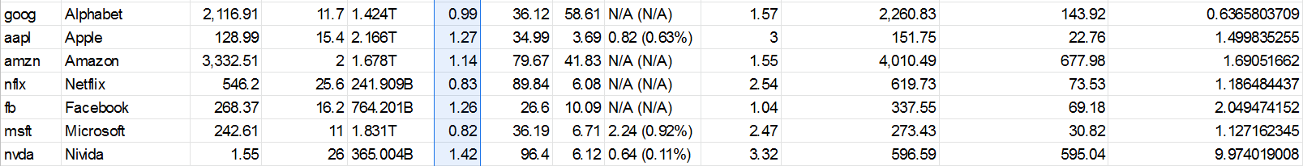
Team’s Pick
Options:
Alphabet
Apple
Amazon
Netflix
Facebook
Microsoft
Nvidia

Slide 15
Team’s Pick
We discussed all on the list and narrowed it down to two.
Apple (AAPL)
Consumer Technology
PE ⅓ of Nvidia
Nvidia (NVDA)
PC Extension Cards
Innovation index MC-E 2X Apple
Recently offered dedicated crypto mining cards

Slide 16
Team’s Pick
Nvidia (NVDA)
March 5th Price Per Share: $502.00
Number of Shares Purchased: 49
Total Purchase Price: $24,598
Leftover Cash: $402.00

Slide 17
Totals
Salesforce.com (CRM) - 119 shares
Nvidia (NVDA) - 49 shares
Ulta! (ULTA) - 75 Shares
AirBnB (ABNB) - 136 Shares
Leftover Cash: $838.09

